Slide 1
Time-Series Forecasting with Auto encoders
SUBMITTED BY
RAGAVI PRABHA M
NM ID: au711721243073
KGiSL INSTITUTE OF TECHNOLOGY
3/21/2024 Annual Review

Slide 2
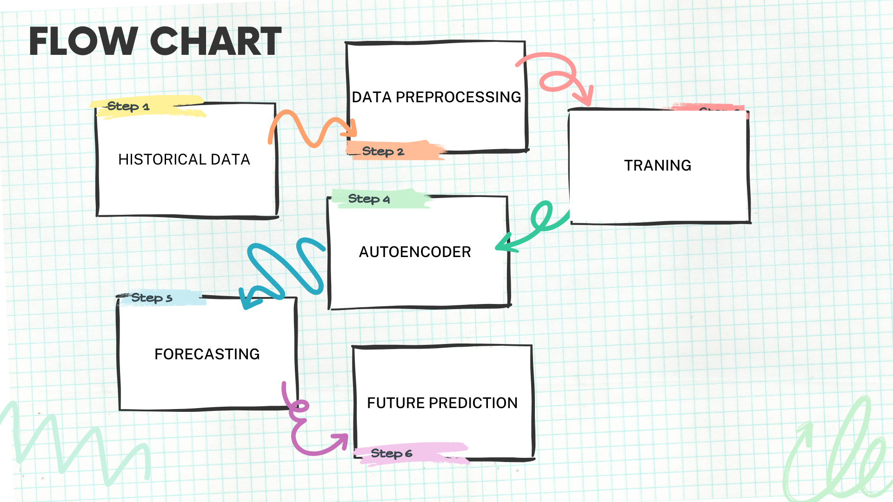
Time-Series Forecasting with Autoencoders
3/21/2024 Annual Review

Slide 3


AGENDA
PROBLEM STATEMENT
PROJECT OVERVIEW
END USERS
SOLUTION AND PROPOSITION
KEY FEATURES
MODELLING APPROACH
RESULT
3/21/2024 Annual Review

Slide 4

PROBLEM STATEMENT
The objective of the project is to create a time-series forecasting solution using autoencoder technology. The focus lies on effectively capturing temporal relationships and patterns in the data to produce precise predictions of forthcoming data points. By harnessing the capabilities of autoencoders, the aim is to overcome the complexities of forecasting in dynamic and evolving time-series datasets.
3/21/2024 Annual Review

Slide 5

PROJECT OVERVIEW
This project delves into utilizing autoencoders for time-series forecasting, with the goal of constructing a model adept at discerning complex temporal patterns inherent in sequential data. Through the process of encoding and decoding time-series data, the autoencoder enables precise forecasts of future values, thereby providing valuable insights into forthcoming trends and behavior.
3/21/2024 Annual Review

Slide 6

WHO ARE THE END USERS?
Financial analysts can leverage the time-series forecasting model based on autoencoders to predict stock prices, currency exchange rates, or other financial metrics, thus assisting in investment decision-making.
Professionals in the energy sector can utilize the model to predict energy consumption patterns, optimize energy production, and strategize resource allocation for enhanced efficiency and sustainability.
3/21/2024 Annual Review

Slide 7

YOUR SOLUTION AND ITS VALUE PROPOSITION
The project entails generating synthetic time-series data, developing and training an autoencoder model, and assessing its performance. The key benefit lies in the autoencoder's capability to grasp temporal patterns within the data, leading to precise predictions of future values. This solution provides valuable insights into forthcoming trends and behavior, thereby enabling informed decision-making across diverse domains such as finance, energy, and healthcare.
3/21/2024 Annual Review

Slide 8
THE WOW IN YOUR SOLUTION
Enabling accurate forecasting of future values
Learns meaningful representations from sequential data
Better understanding
Better prediction of complex temporal dynamics
Decision making across various domains
Offers insights into future trends
Improved Accuracy, Scalability and interpretability of forecasts
3/21/2024 Annual Review

Slide 9
MODELLING
AUTOENCODER MODEL:
The autoencoder model is composed of LSTM (Long Short-Term Memory) layers, designed to process sequential data efficiently. It receives a sequence of input data points and encodes them into a condensed representation with lower dimensions. Subsequently, another set of LSTM layers decodes this representation back into the original sequence. During training, the autoencoder minimizes the mean squared error loss between the input and output sequences, effectively learning to reconstruct the input sequence while capturing its temporal patterns.
SEQUENCE GENERATION MODEL:
Upon training completion of the autoencoder, a separate function is employed to generate new sequences of future data points. This function operates by taking a seed sequence as input and iteratively generating new data points. It achieves this by feeding the previous data point into the autoencoder, which in turn learns to predict the subsequent data point based on the preceding ones. Thus, the autoencoder adeptly captures the temporal dependencies present in the data, enabling the generation of accurate sequences representing future trends.
3/21/2024 Annual Review

Slide 10
DATA GENERATION:
Synthetic time-series data is generated with two sine waves and random noise using the “generate_time_series_data” function.
2. MODEL CREATION AND TRAINING:
An autoencoder model is created using LSTM layers with specified architecture in the “create_autoencoder” function.
The autoencoder model is trained on the generated time-series data using the “train_autoencoder” function. The model is optimized to minimize the mean squared error loss between the input and output sequences.
3. SEQUENCE GENERATION:
After training the autoencoder, a new sequence of future data points is generated using the “generate_new_sequence” function.
This function takes a seed sequence and iteratively predicts future data points based on the learned patterns in the autoencoder model.
4. VISUALIZATION:
Finally, the original seed sequence and the generated future sequence are plotted for comparison using Matplotlib.

Slide 11
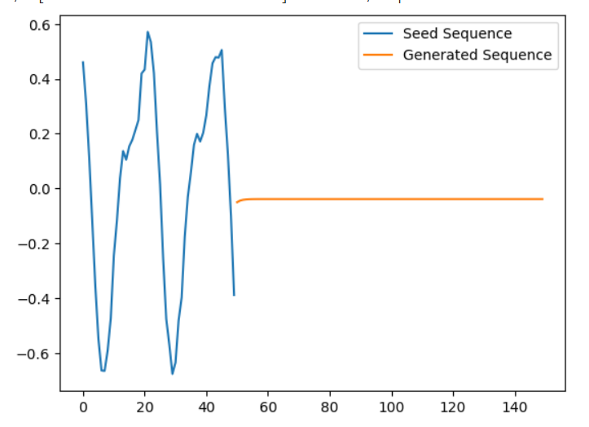
RESULTS
The project's results demonstrate the autoencoder's ability to accurately forecast future values in time-series data, showcasing its effectiveness in capturing temporal patterns and generating precise predictions.
https://drive.google.com/file/d/1E2lLc1FGSRKmYAylv0-BC-nsH2qHvzf7/view?usp=sharing
3/21/2024 Annual Review

